Slide 1
Autocorrect+ AI-Enhanced Descriptive Answer Evaluation
Gayathri Devi Atluri- gatluri@kent.edu – 811256395
Harika Malneedi- hmalneed@kent.edu-811255562
Sai Haritha Udatha- sudatha@kent.edu- 811238202
Bhanu siva kumar komanna- bkomman1@kent.edu- 811252220
Mani Surya Teja Kota- mkota1@kent.edu- 811262686
Veeraraghava raju Lolabhattu- klolabha@kent.edu- 811301662

Slide 2
Abstract

Slide 3
Introduction

Slide 4
Literature Review

Slide 5
What?

Slide 6
Why?

Slide 10
Technologies
NLP Algorithm
Jaccard Distance
Cosine similarity
CountVectorizer
Notes:
The system utilizes state-of-the-art NLP algorithms, including cosine similarity and Jaccard distance, to assess the similarity between student answers and model solutions.
By tokenizing and preprocessing the text, stopwords are removed, and meaningful word representations are extracted.
This allows for a comprehensive analysis of the semantic similarity between answers, enabling precise grading based on content rather than just keyword matching.
Furthermore, AutoCorrect+ employs machine learning models, such as CountVectorizer and cosine similarity, to quantify the textual similarity between answers.
By training on annotated datasets of graded answers, the system learns to predict grades based on the extracted features, providing accurate assessments aligned with human evaluators judgments.
Overall, AutoCorrect+ revolutionizes the grading process for educators, offering a reliable, efficient, and consistent solution for correcting descriptive answer sheets.
Through its integration of cutting-edge NLP and machine learning techniques, AutoCorrect+ sets a new standard for automated grading systems, empowering educators to focus more on teaching while ensuring fair and objective evaluation of student responses.

Slide 11
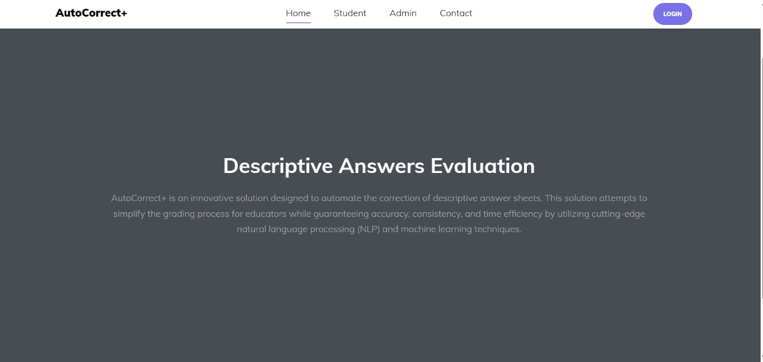
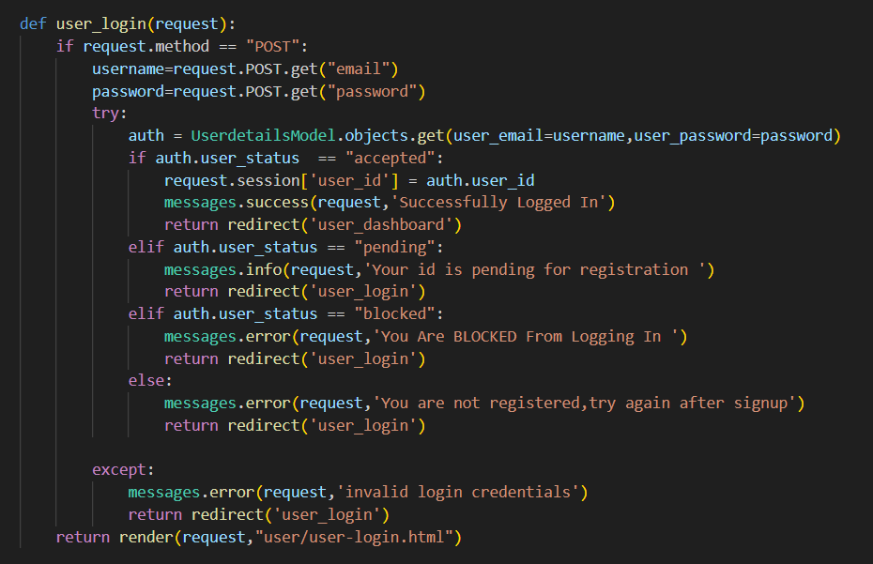
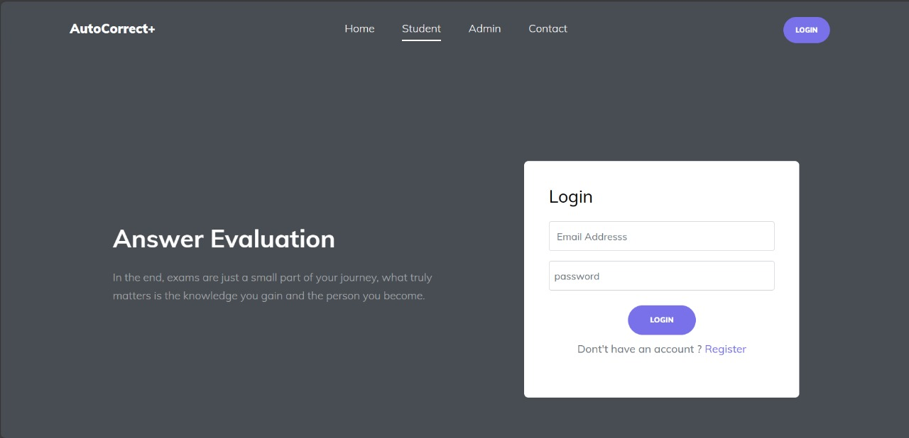
The Login Page
Notes:
This is the front-end part , the user interface part. This is the home page where we need to login.
If the user is new they need to register with the mandatory fields and then they can sign in and also we have Admin Login.
Admin Login is for the master user who has access to all courses, question and answers related to those courses.
While users have access to the page where they can only access the course tests.

Slide 12
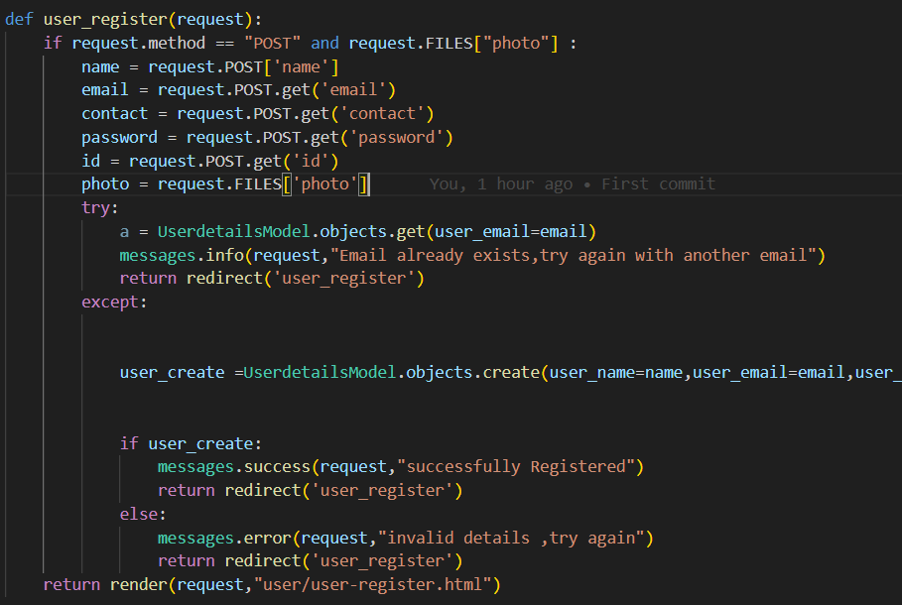
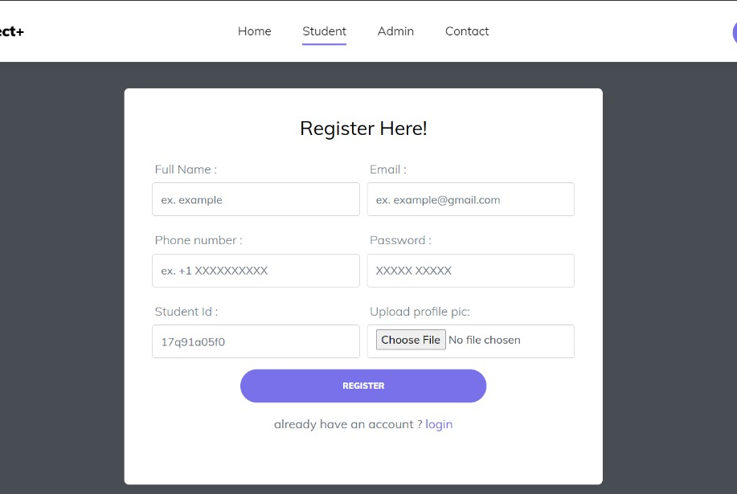
New User Registeration
Notes:
Any New user have to register their account providing all the required details.
the request method is POST, indicating that the user has submitted a registration form. After they filled the forms it will check for all the required mandatory fields and then it submits
If the registration is success the user will be redirected to login page

Slide 13
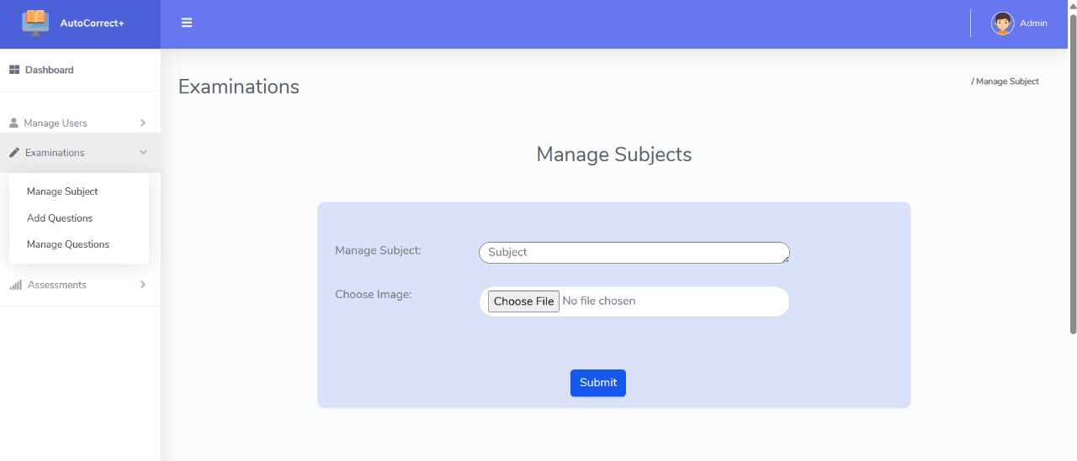
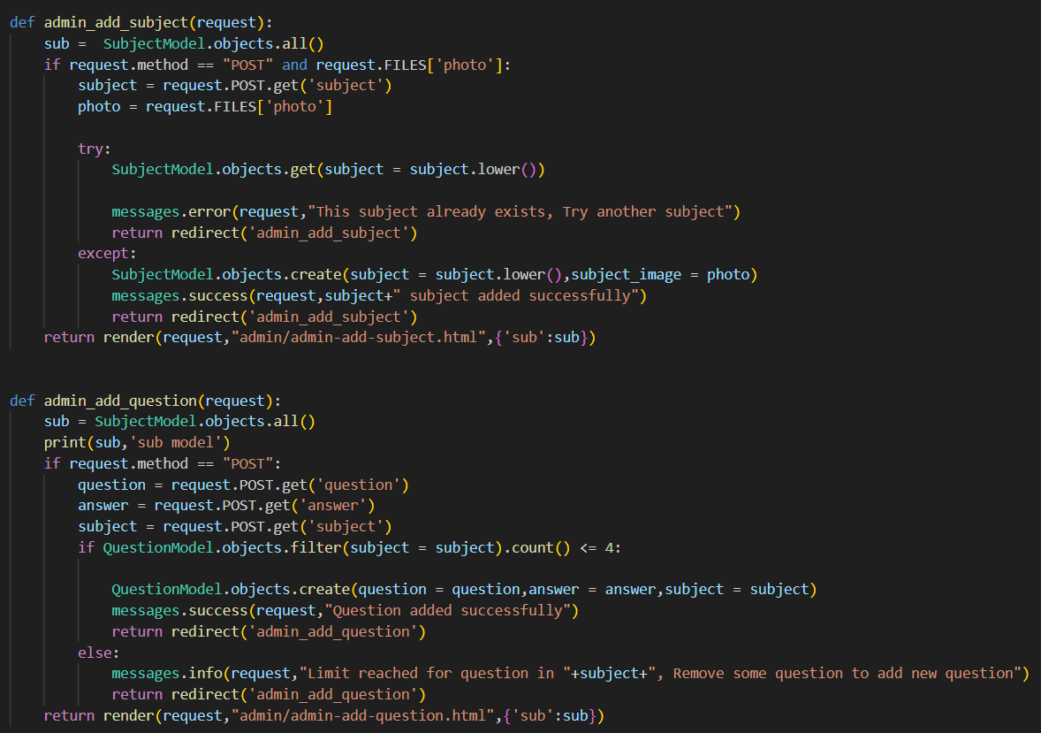
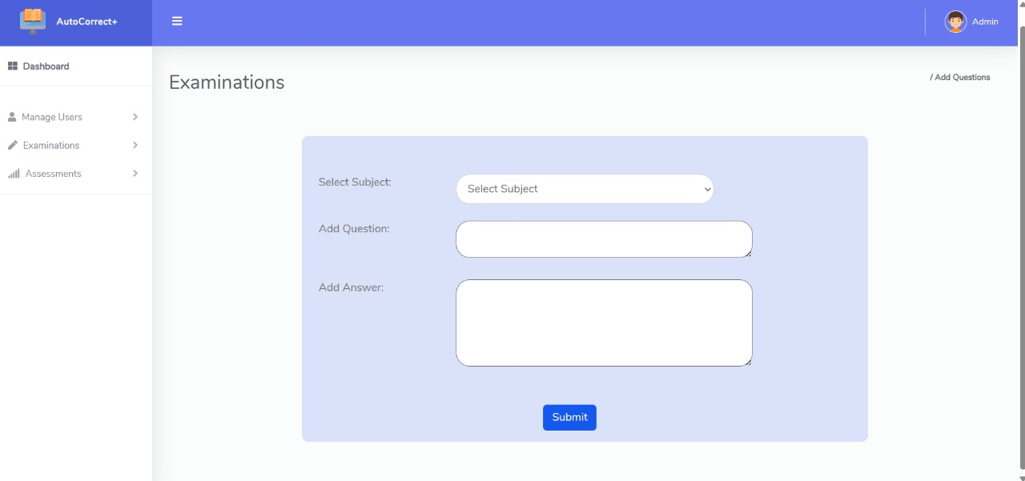
Notes:
Admin can add or remove subjects. Admin can add question and answers for the subjects. User can login, take exam and view grades. Before adding it checks for existing data and then it will update. Else error handling function will display error message.

Slide 14
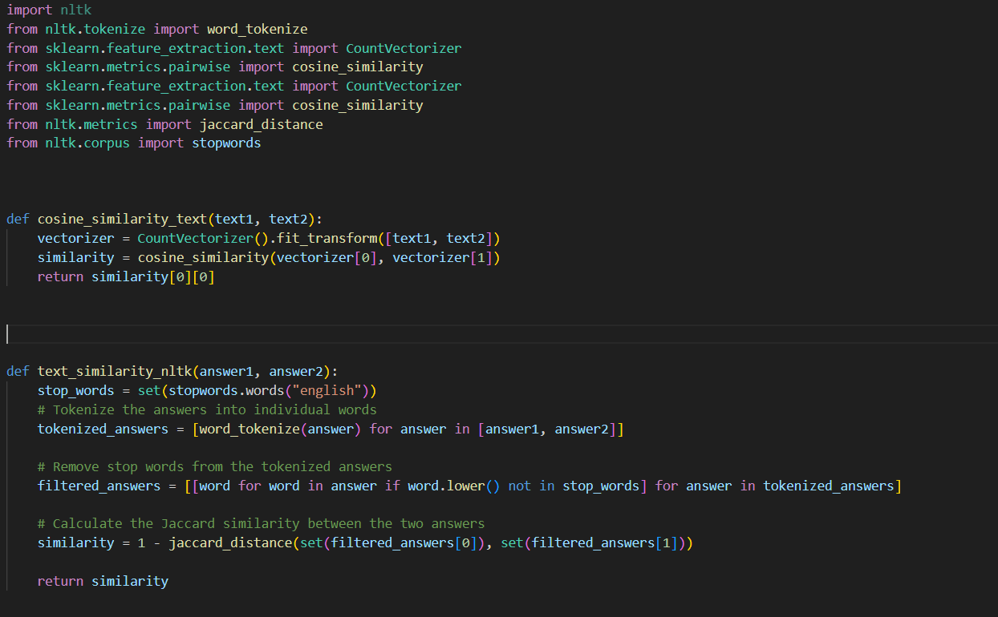
Notes:
This function calculates the cosine similarity between two text inputs text1 and text2 using the Bag-of-Words approach.
It first initializes a CountVectorizer object, which converts the text inputs into numerical vectors. Each vector represents the frequency of each word in the text.
The fit_transform method of CountVectorizer converts the input texts into a document-term matrix.
The cosine_similarity function from scikit-learn computes the cosine similarity between the vectors representing text1 and text2.
Cosine similarity measures the cosine of the angle between two vectors, indicating how similar they are irrespective of their magnitude.
Jaccard similarity measures the similarity between two sets by computing the ratio of the size of their intersection to the size of their union.

Slide 15
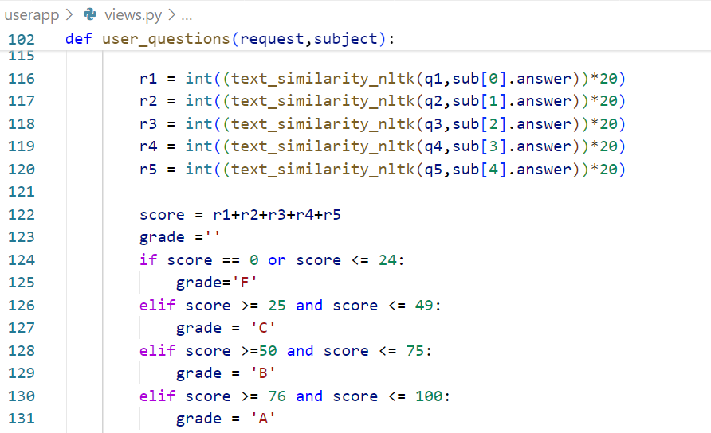
Project Progress
Notes:
We worked on the code which assigns grades to users based on their answers.
“The code calculates a similarity score between the user's answers and the correct answers for each of the five questions (q1, q2, q3, q4, q5). It uses the text_similarity_nltk function from the NLTK (Natural Language Toolkit) library to compute the similarity. The similarity score is then scaled to a range of 0-100 by multiplying it by 20 and converting it to an integer.
After calculating the individual similarity scores, the code computes the total score (score) by summing up the scores for each question (r1, r2, r3, r4, r5).
Based on the total score, the code assigns a letter grade (grade) to the user's performance. If the total score is between 0 and 24, the grade is 'F'; between 25 and 49, the grade is 'C'; between 50 and 75, the grade is 'B'; and between 76 and 100, the grade is 'A’.”

Slide 16
Pending Tasks
Add Admin functionalities like manage and add question and users.
Adding analyse function
Given admin access to register a user
Add some better UI interface functions for better user experience
Notes:
To give admin some new functions where admin can add or mange courses.
And he can add or manage the questions and answers accordingly. Based on the results he can also view analysis graph of each student in a particular course.
If a user registers then instead of creating a account it will send acknowledgement to admin then admin can accept or reject the acknowledgement then only the user can login.

